Slide 1
DataSorting Application
USER GUIDE

Slide 2
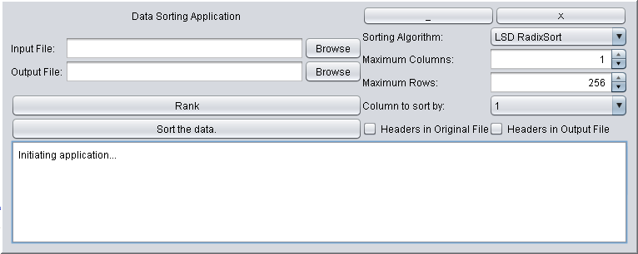
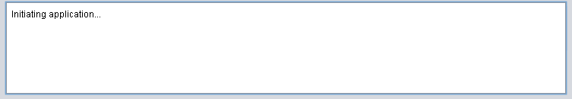
General User Interface
Click any component below to view information about its function.

Slide 3
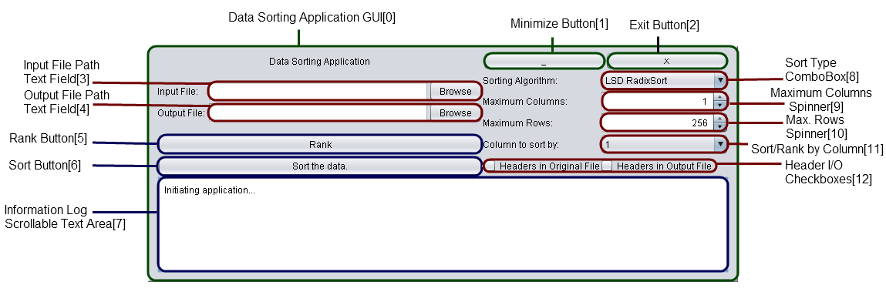
Interface Components

Slide 4
Application Window
The application window is a custom rendered window that can be dragged across the screen simply by left-clicking wherever there is empty space and moving the cursor.
The window cannot be resized, and as a result it cannot be put in full-screen mode or maximized.

Slide 5
Minimize Button
The minimize button sets the window’s state as its minimized state, effectively hiding the window in the taskbar.

Slide 6
Exit Button
The exit button terminates the application, stopping all threads and freeing memory used by this application.

Slide 7
Input File path Text Field/Button
The combination of a text field and button allows you to either type the path of the input file or find the file itself through a file chooser sub-window. Using the file chooser to fill this field will auto-fill the output box as:
Drive:\Directory\Folder\Sub-Folder\filename.out.csv

Slide 8
Output File path Text Field/Button
This field and button performs the same action as the input file field, however, this is not required to be filled out (as it can be auto-filled when selecting an input file).

Slide 9
Rank Button
This button will trigger a rank sort, a process that will sort the values, rank them, and replace them in their original order. This allows for direct comparison of elements in larger sets of data.

Slide 10
Sort Button
This button triggers a straight sort, in which the application will output a copy of the data sorted according to the chosen entries.

Slide 11
Information Log Text Area
A means of communicating with the user, this scrollable text area conveys all messages, information, and warning when using this application.

Slide 12
Sort Type ComboBox
This gives the user the ability to select the best type of sorting algorithm that they deem suitable of their data.
For example, the Least-Significant-Digit radix sort excels in sorting large amounts of data in a short time, whereas sorts such as the bubble sort can be used if one suspects the data is already (or is almost) in order.

Slide 13
Max. Column Spinner
This field limits the sort to the first n columns of data, useful if you do not need to have certain columns in the sorted data.
This application has an enforced limit of 256 columns (2⁸).

Slide 14
Max. Row Spinner
This field limits the number of data entries to be sorted, allowing the user to sort only the top n elements, ignoring any remaining elements.
This application has an enforced max limit of 65536 entries (2¹⁶)

Slide 15
Sort By: ComboBox
This combination box gives the user control over how the data is sorted. This field will select the column of data that will determine the order of the sorted data.
This application will not allow you to sort the data by a column not included in the sort itself.

Slide 16
Header I/O Checkboxes
The first checkbox denotes whether the input file has labels/headers in the initial row, allowing the application to skip that row and sort the rows after the first one.
The second checkbox denotes whether the user wants headers in the first row of the output file. Note that if both boxes are checked, the application will use the original headers.

